Slide 1

PROJECT DEMOSTRATION

Slide 2

SMART INVENTORY SYSTEM

Slide 3
INTRODUCTION
Smart inventory is an application in which any organization can manage their inventory and customer through this application. We had automated every process in the Smart Inventory application which eliminates manually keeping the inventory records.
Manage all your Inventory at a single platform.
Better and more reliable.
Fast and easy to learn.

Slide 4
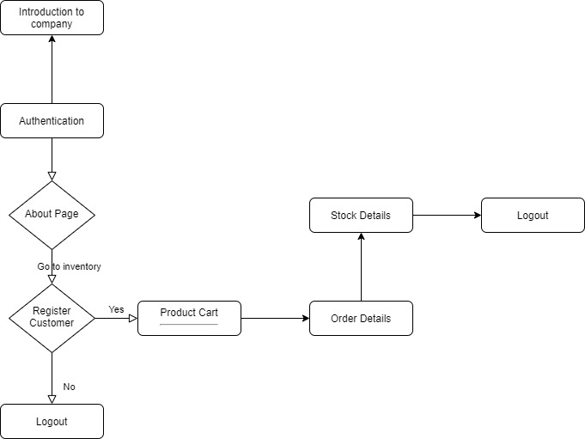
WORK FLOW

Slide 5

TEAM MEMBERS
NABHAM
TARUN
NAVNEET
SHUBHAM
YASH
JATIN
AKANSH

Slide 6
THANK YOU

